Slide 1
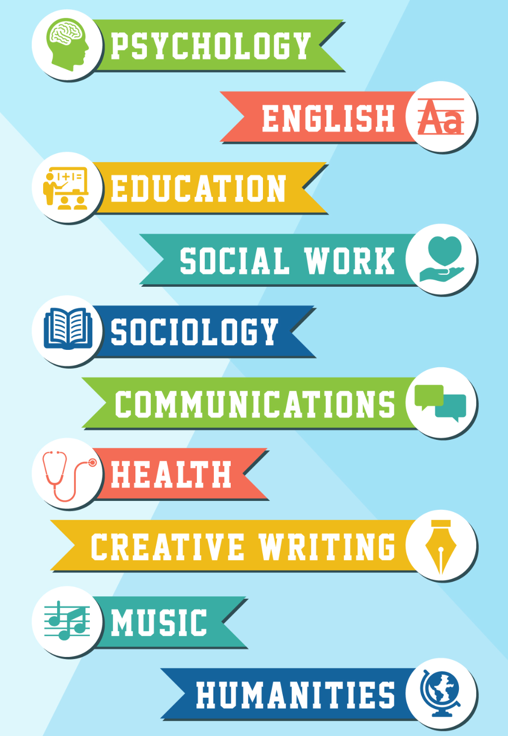

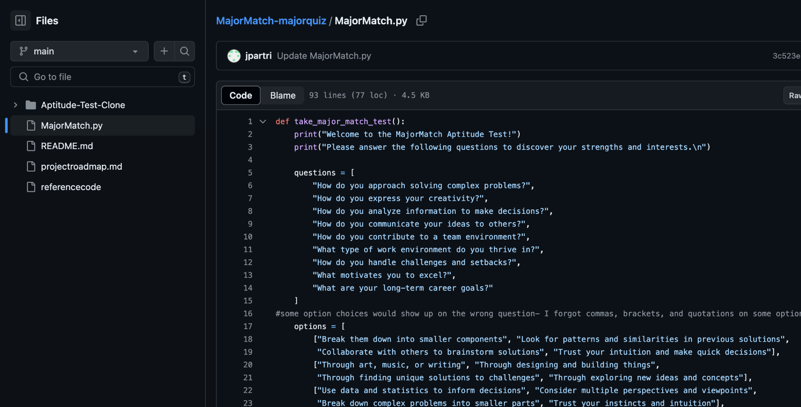
MajorMatch
https://github.com/ksu-is/MajorMatch-majorquiz/tree/main By: Benaiah Noah & Jake Partridge
Made to help students see potential college majors after just answering a few questions about their interests and skills. This is a difficult decision for young adults, MajorMatch is here to make that decision simpler.

